Slide 1
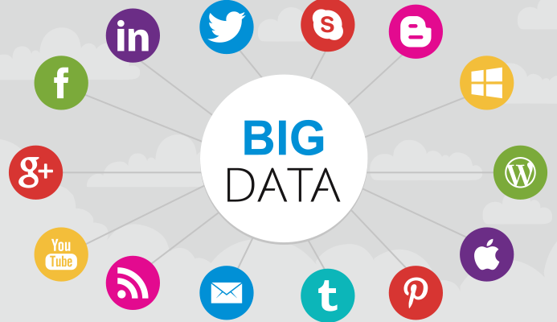
Big Data

Slide 2
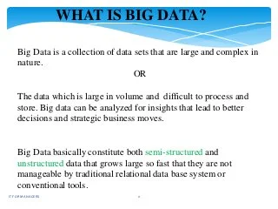

Slide 3
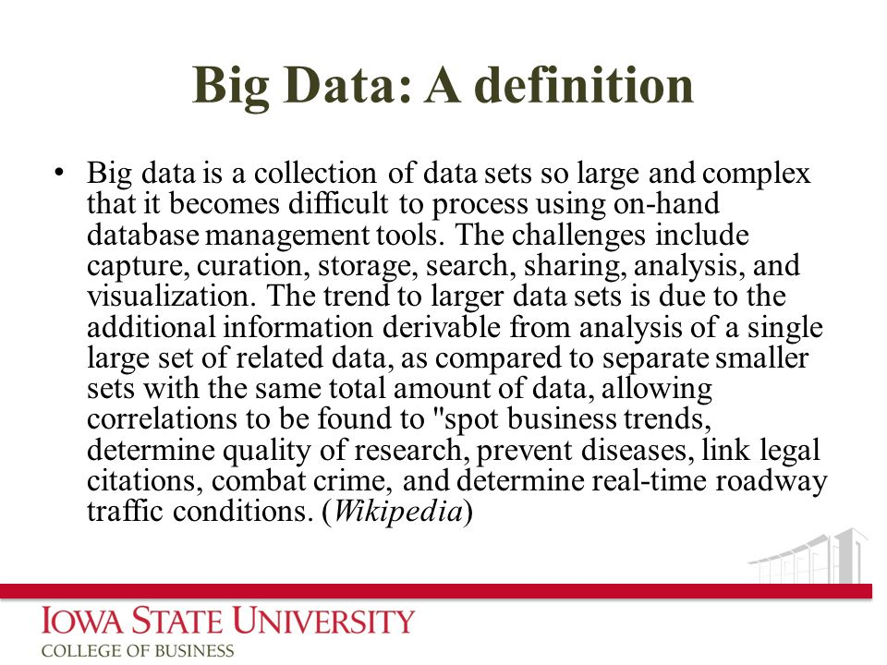

Slide 4
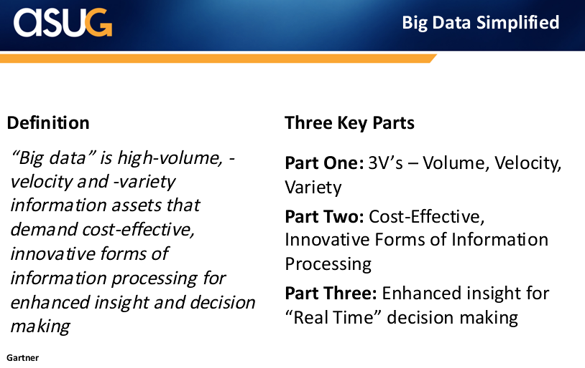

Slide 5
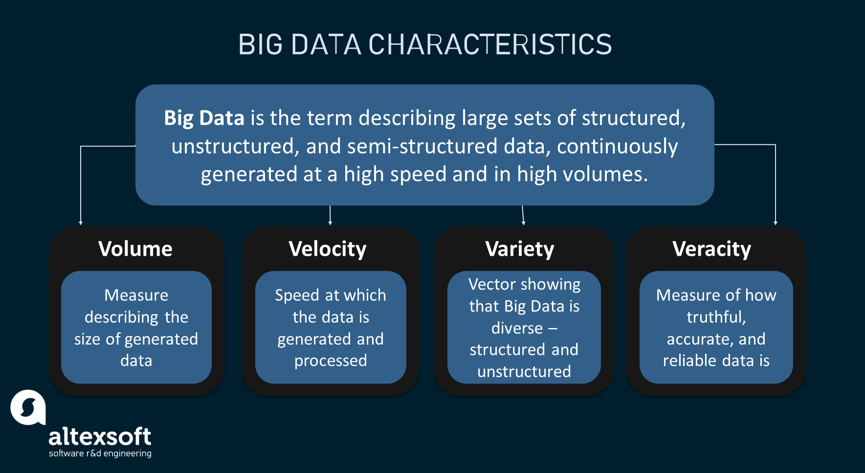

Slide 6
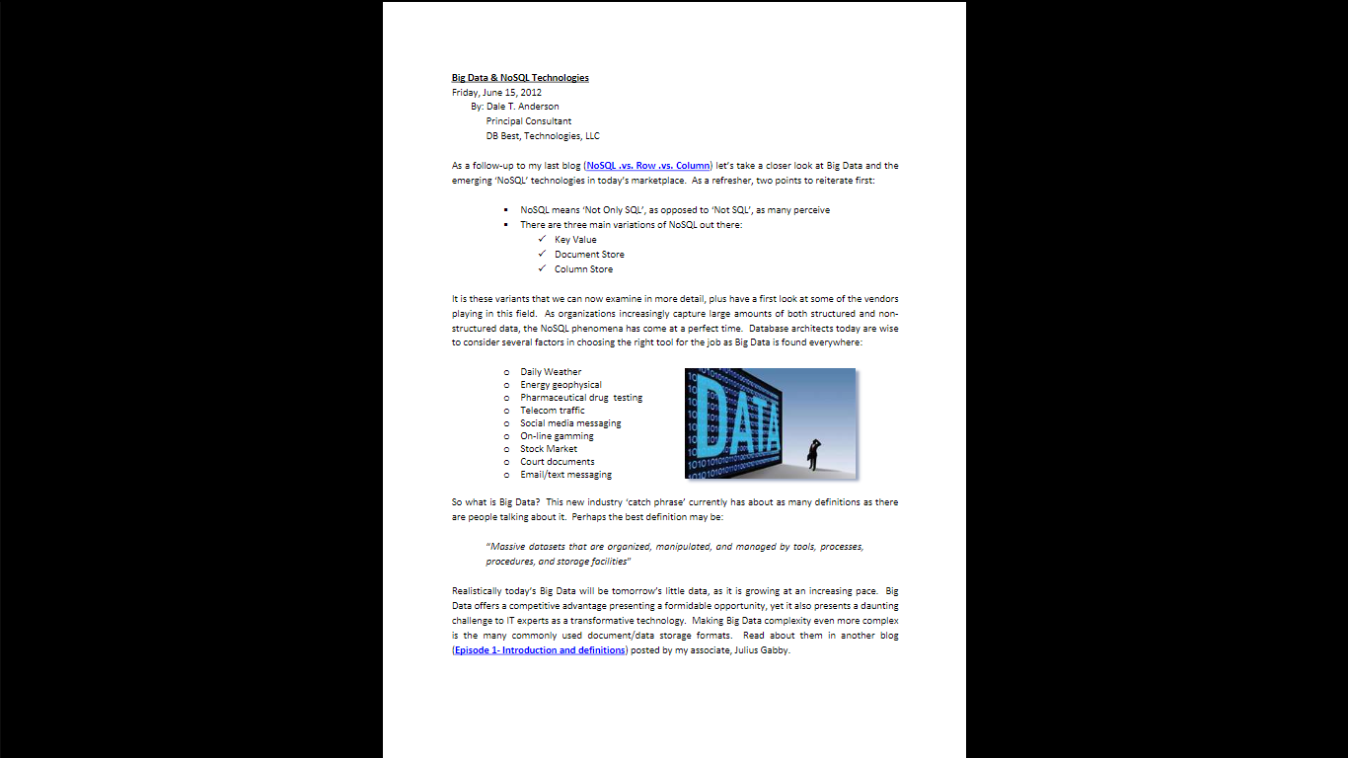

Slide 7
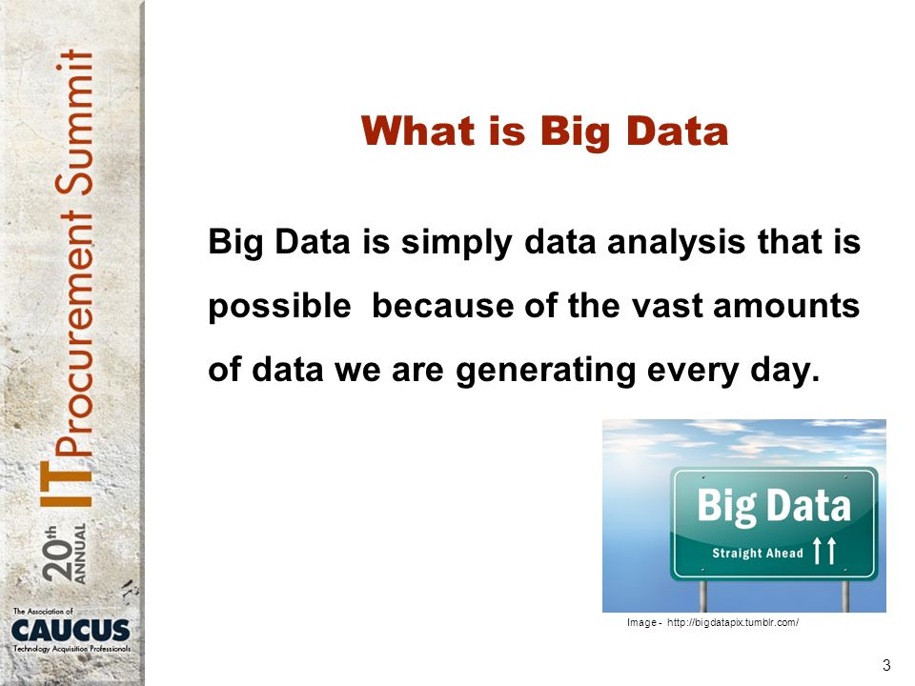

Slide 8
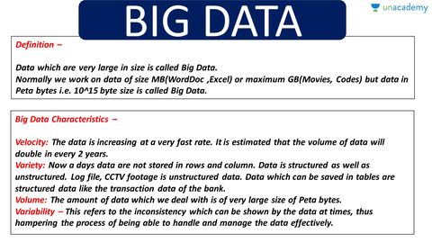

Slide 9
Big Data contains a large amount of data that is not being processed by traditional data storage or the processing unit. It is used by many multinational companies to process the data and business of many organizations. The data flow would exceed 150 exabytes per day before replication.
What is the importance of Big Data?
Finding the root cause of failures, issues and defects in real time operations.
Recalculating entire risk portfolios in just minutes.
Detecting fraudulent behavior before it affects and risks your organization.
Big user of this Technology?
Banking
Government
Education
Health Care
Manufacturing
Retail

Slide 10
CHARACTERISTICS OF BIG DATA :The term Big Data refers to gigantic larger datasets (volume); more diversified, including structured, semi-structured, and unstructured (variety) data, and arriving faster (velocity) than before. These are the 5V.
-Volume: represents the amount of data generated, stored and operated within the system. The increase in volume is explained by the increase in the amount of data generated and stored, but also by the need to exploit it.
-Variety: represents the multiplication of the types of data managed by an information system. This multiplication leads to a complexity of links and link types between these data. The variety also relates to the possible uses associated with a raw data.
-Velocity: represents the frequency at which data is generated, captured, and shared. The data arrive by stream and must be analyzed in real-time.
-Veracity: level of quality, accuracy, and uncertainty of data and data sources.
-Value: the value and potential derived from data.

Slide 11
Volume: The name Big Data itself is related to an enormous size. Big Data is a vast 'volumes' of data generated from many sources daily, such as business processes, machines, social media platforms, networks, human interactions, and many more.
Facebook can generate approximately a billion messages, 4.5 billion times that the "Like" button is recorded, and more than 350 million new posts are uploaded each day. Big data technologies can handle large amounts of data.

Slide 12
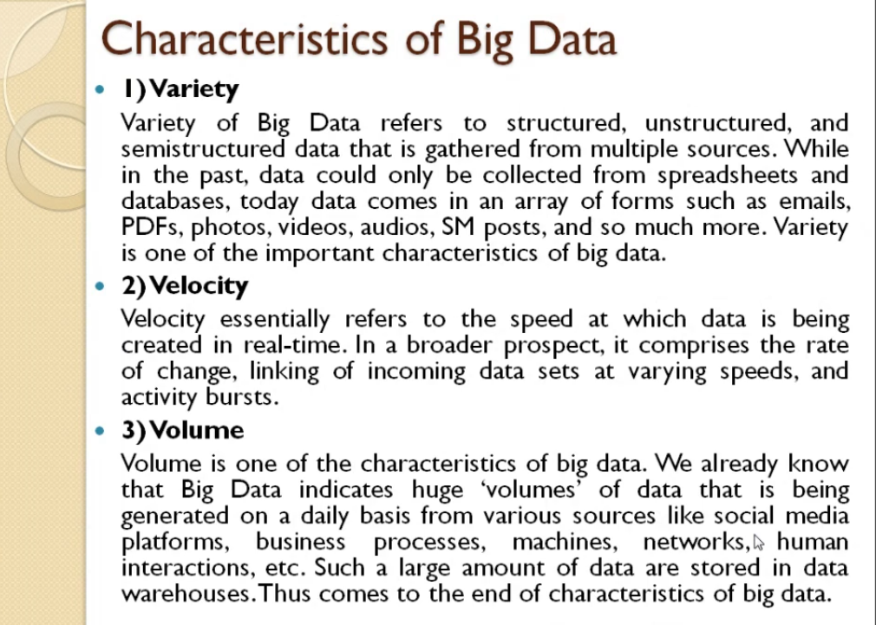

Slide 13
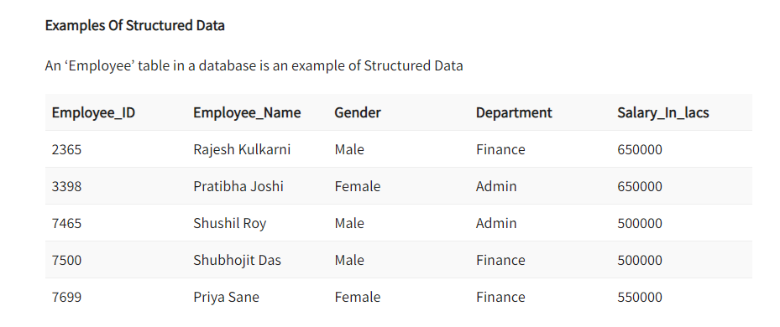
Types Of Big Data Following are the types of Big Data: Structured Unstructured Semi-structured
Any data that can be stored, accessed and processed in the form of fixed format is termed as a ‘structured’ data.

Slide 14
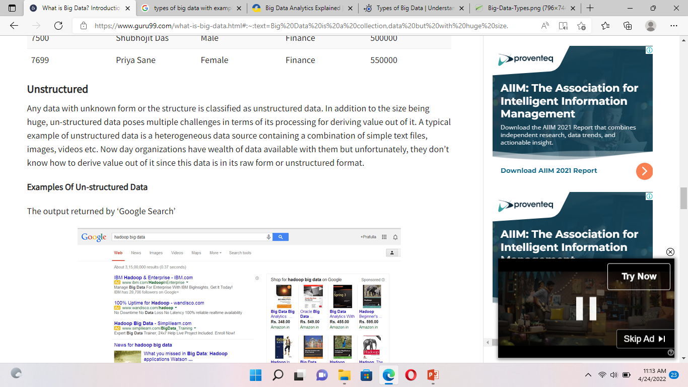
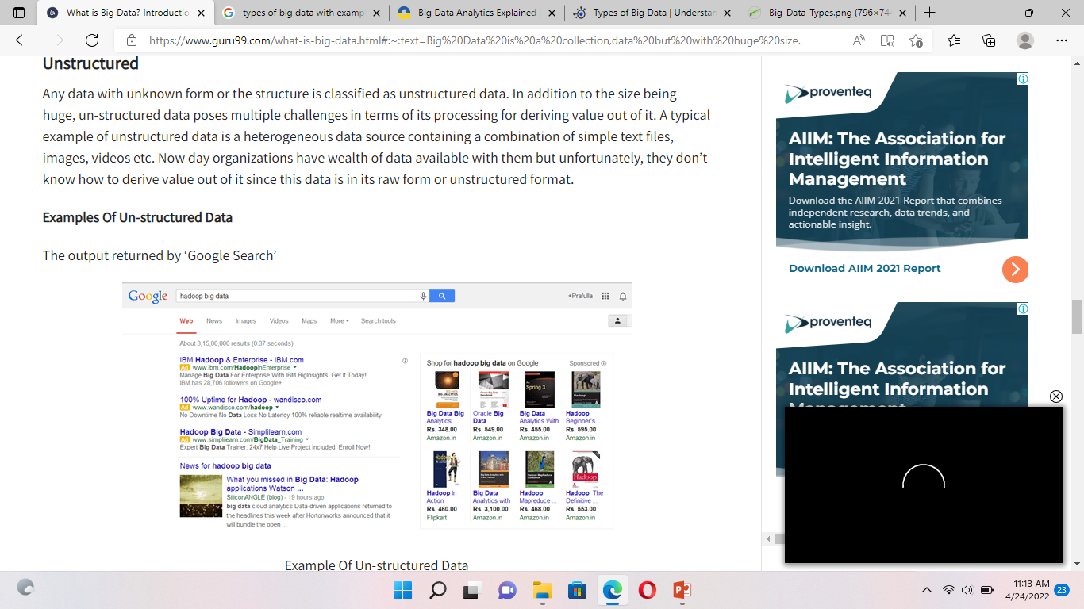

Slide 15
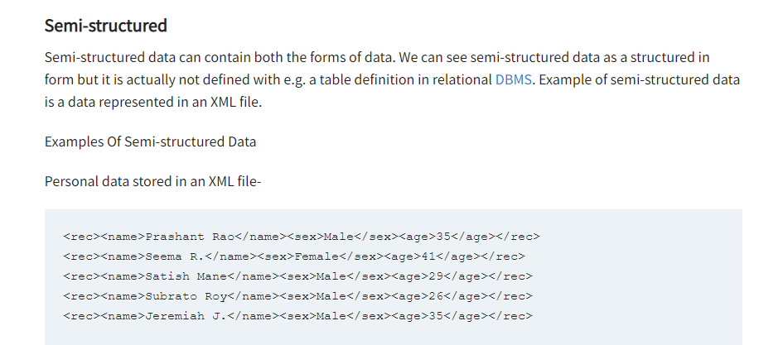

Slide 16
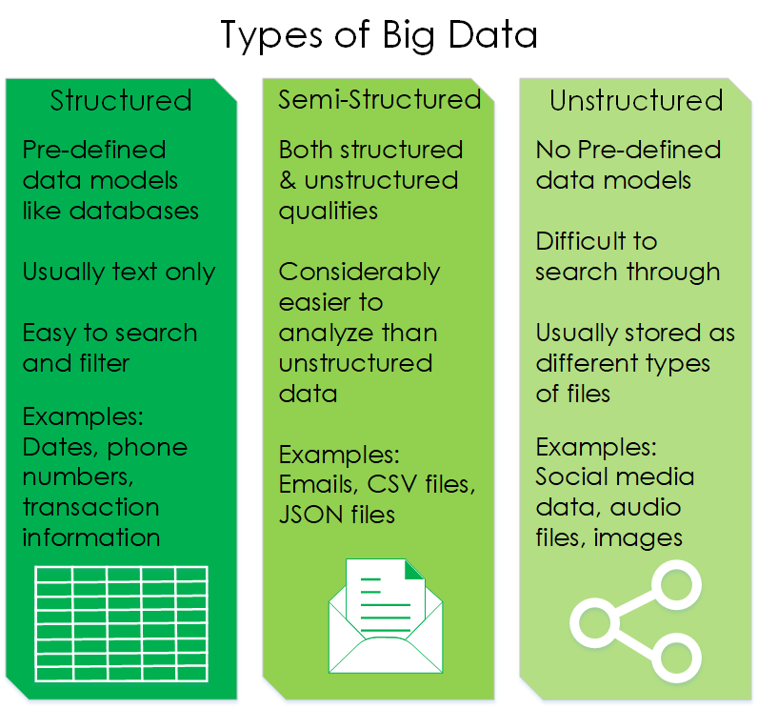

Slide 17
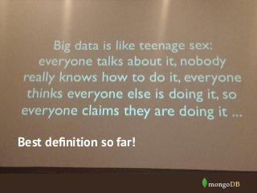

Slide 18
Big Data Applications
These are some of the following domains where Big Data Applications has been revolutionized:
Entertainment: Netflix and Amazon use it to make shows and movie recommendations to their users.
Insurance: Uses this technology to predict illness, accidents and price their products accordingly.
Driver-less Cars: Google’s driver-less cars collect about one gigabyte of data per second. These experiments require more and more data for their successful execution.
Education: Opting for big data powered technology as a learning tool instead of traditional lecture methods, which enhanced the learning of students as well aided the teacher to track their performance better.
Automobile: Rolls Royce has embraced this technology by fitting hundreds of sensors into its engines and propulsion systems, which record every tiny detail about their operation. The changes in data in real-time are reported to engineers who will decide the best course of action such as scheduling maintenance or dispatching engineering teams should the problem require it.
Government: A very interesting use case is in the field of politics to analyse patterns and influence election results. Cambridge Analytica Ltd. is one such organisation which completely drives on data to change audience behaviour and plays a major role in the electoral process

Slide 19
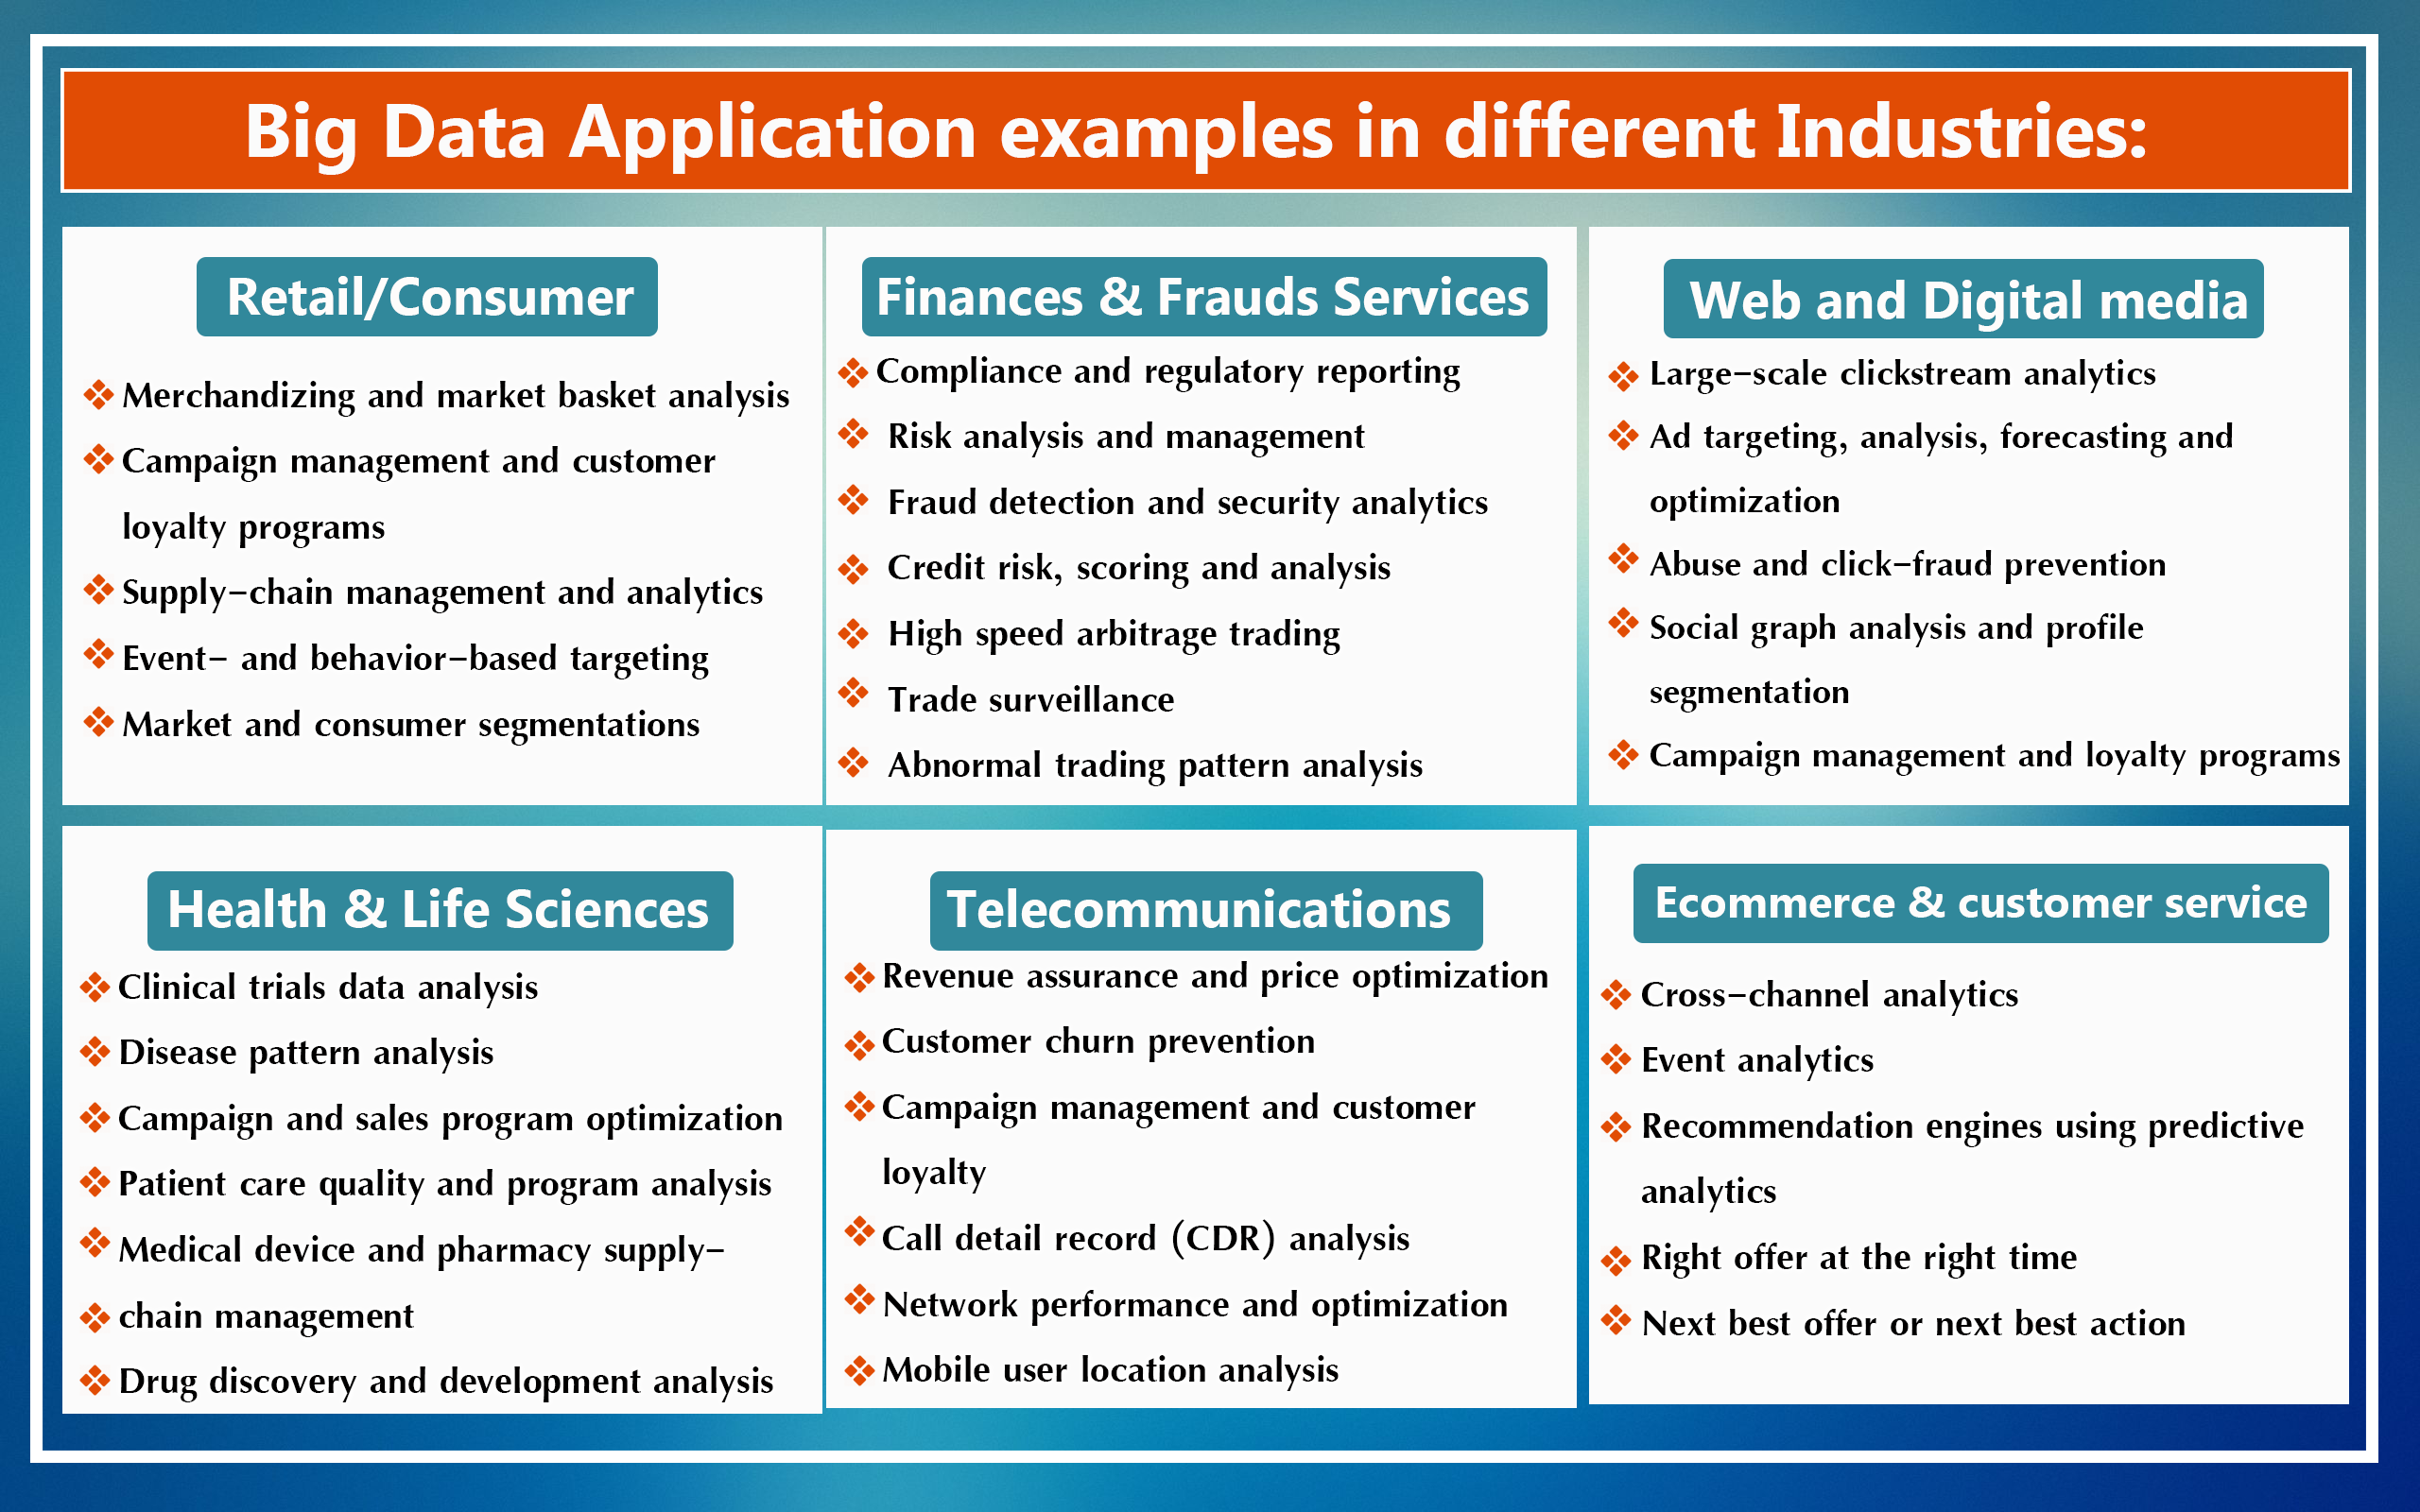

Slide 20
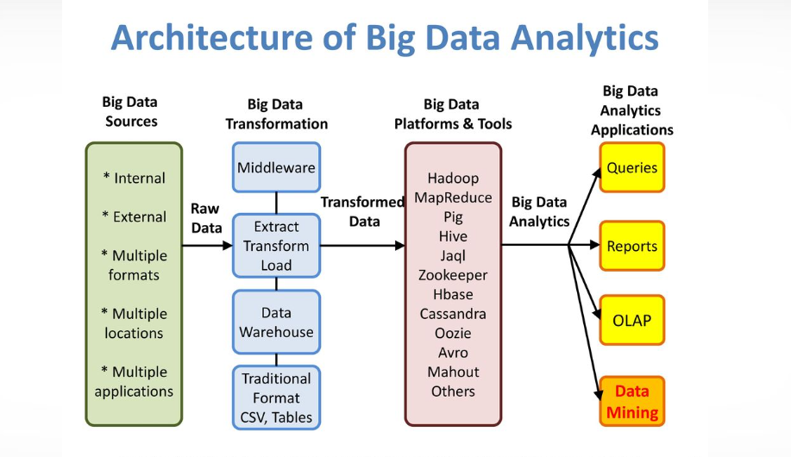

Slide 21
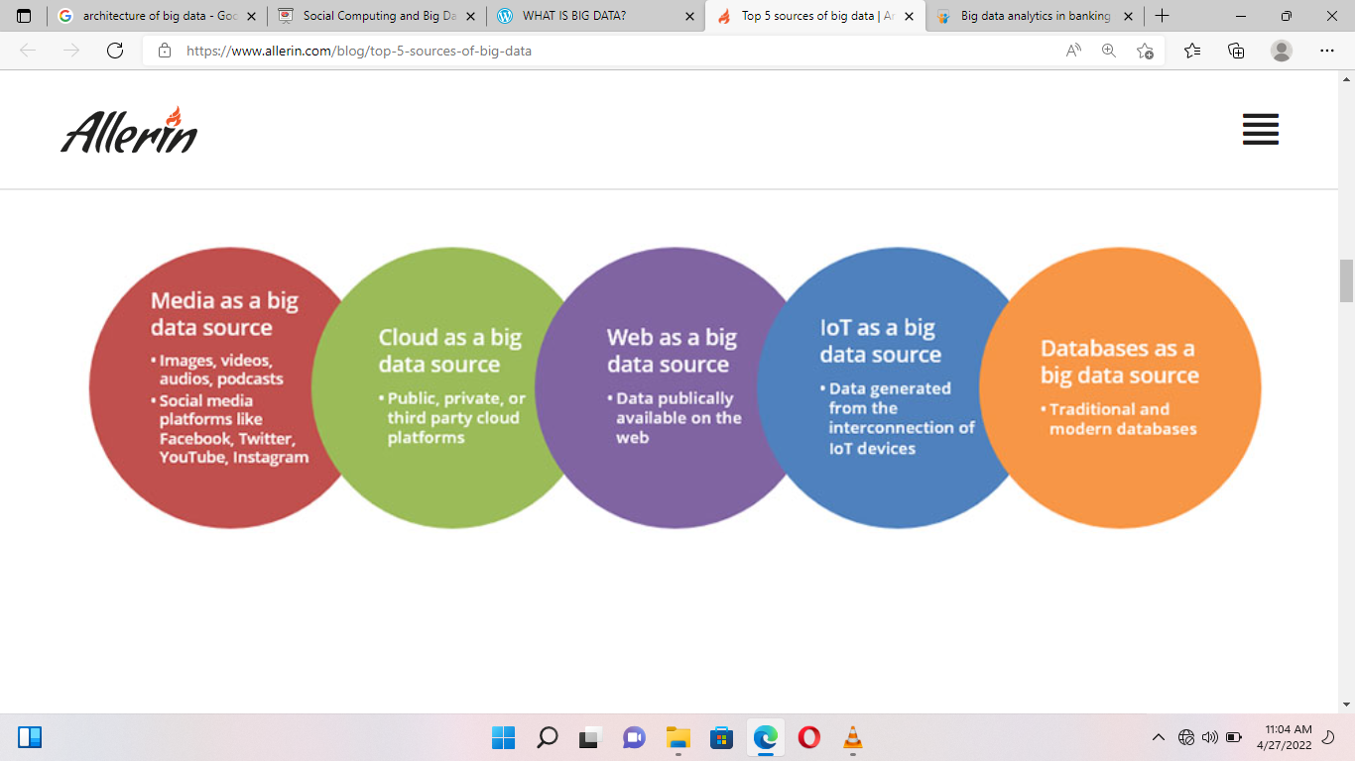
Sources of big data

Slide 24
